Slide 1
Can Graph Neural Network learn an NP-hard problem?
Michael Sun
BU SIAM Chapter Seminar
October 24, 2023

Slide 2
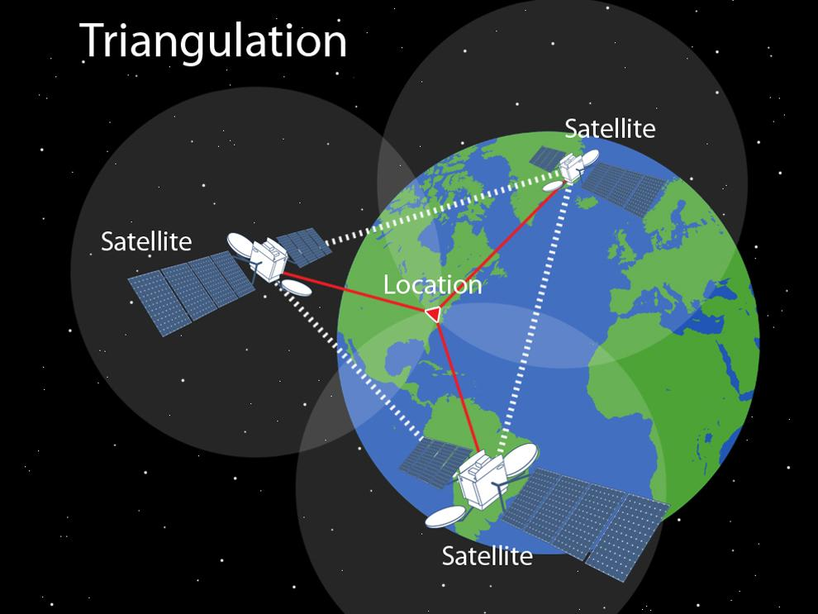
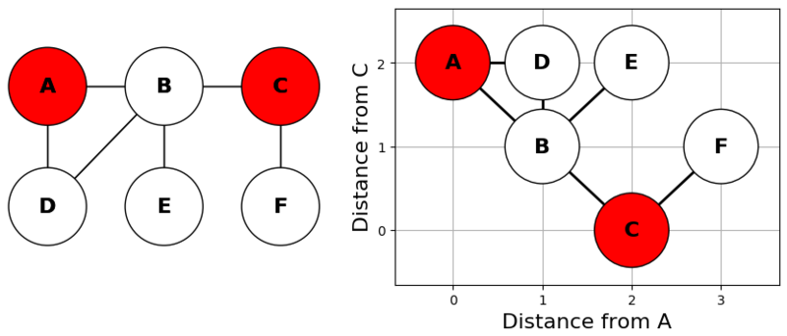
NP-hard problem: GPS on graphs
Metric basis on graphs
Illustration of GPS triangulation

Slide 3
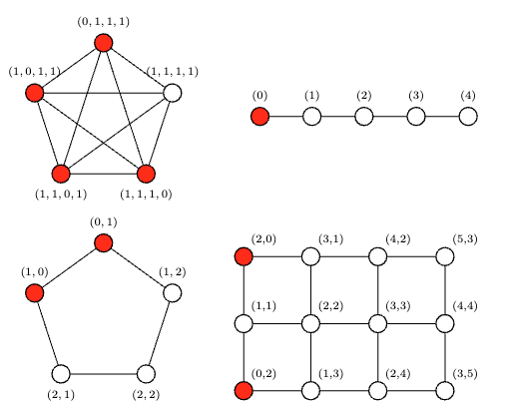
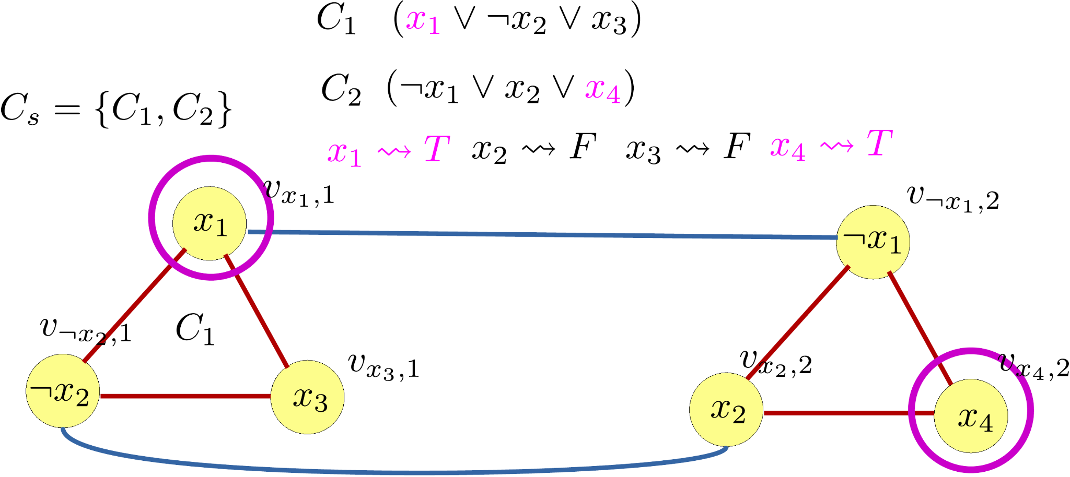
Background: Metric Dimension Problem (MDP)
On a graph G = (V, E), we call S ⊂ V resolving if ∀ u, v ∈ V with u ≠ v, ョ w ∈ V such that d(u, w) ≠ d(v, w). The smallest possible |S| is the metric dimension.
Computing it is NP-hard shown via reduction from 3-SAT (Tillquist).
Tillquist, Richard C. et al. “Getting the Lay of the Land in Discrete Space: A Survey of Metric Dimension and its Applications.” (2021).

Slide 4
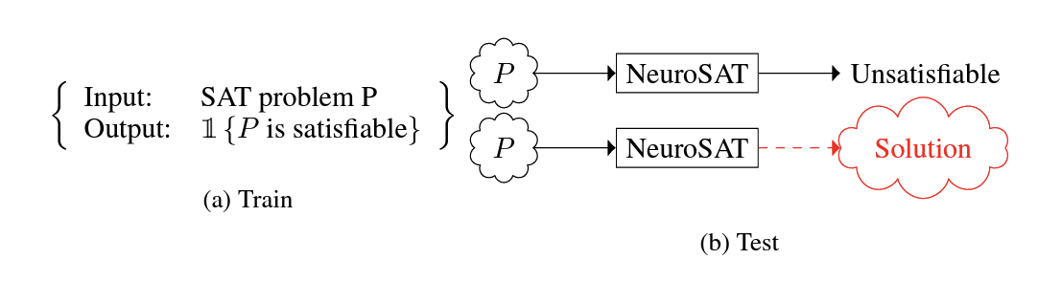
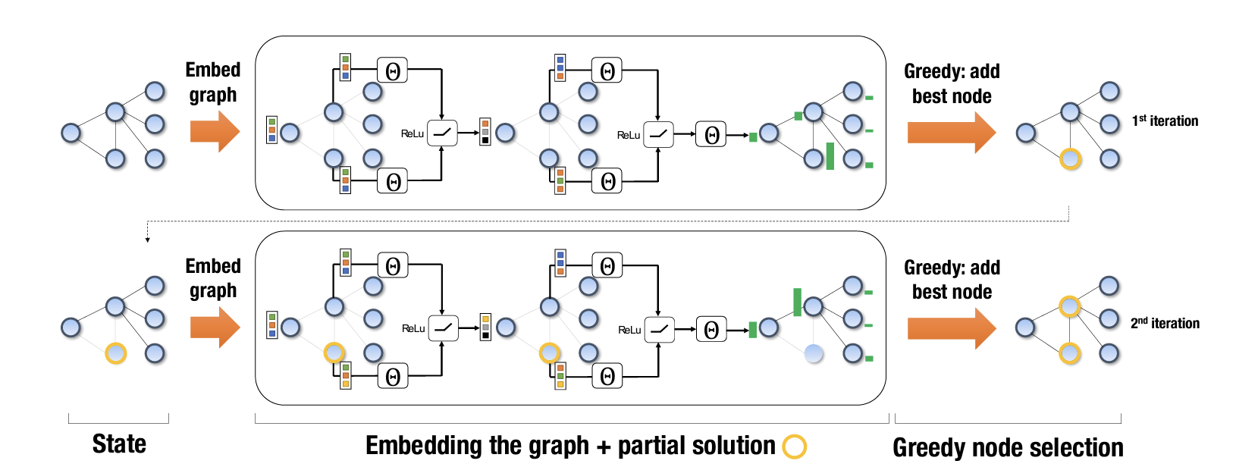
Background: ML + NP-hard
Learn over distribution of solutions
Idea: provide many (problem, solution) instances, can pick up patterns
Learn solution directly (RL)
Idea: learn to build a solution, and use verifier as signal
Selsam, Daniel, et al. "Learning a SAT solver from single-bit supervision." arXiv preprint arXiv:1802.03685 (2018).
Khalil, Elias, et al. "Learning combinatorial optimization algorithms over graphs." Advances in neural information processing systems 30 (2017).
Awesome survey: Bengio, Yoshua, Andrea Lodi, and Antoine Prouvost. "Machine learning for combinatorial optimization: a methodological tour d’horizon." European Journal of Operational Research 290.2 (2021): 405-421.

Slide 5
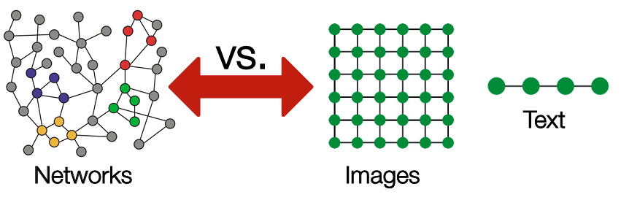
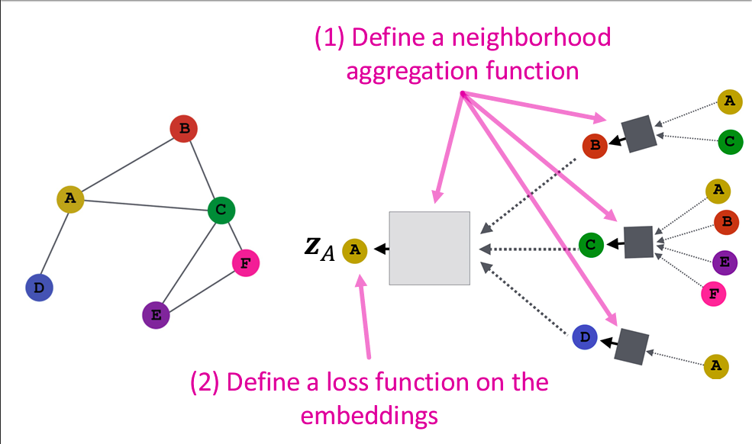
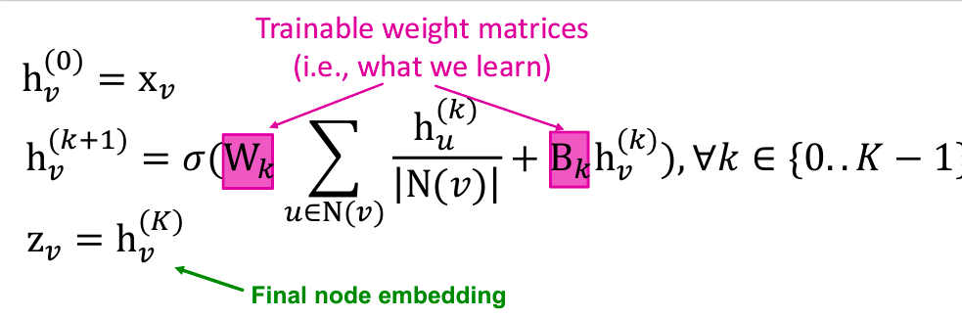
Background: Graph Neural Networks (GNN)
GNN => neural network on graphs
Images/text are special cases of graphs
Unlike images/text, there is no coordinate system to “anchor” nodes
Stanford CS224W slides

Slide 6
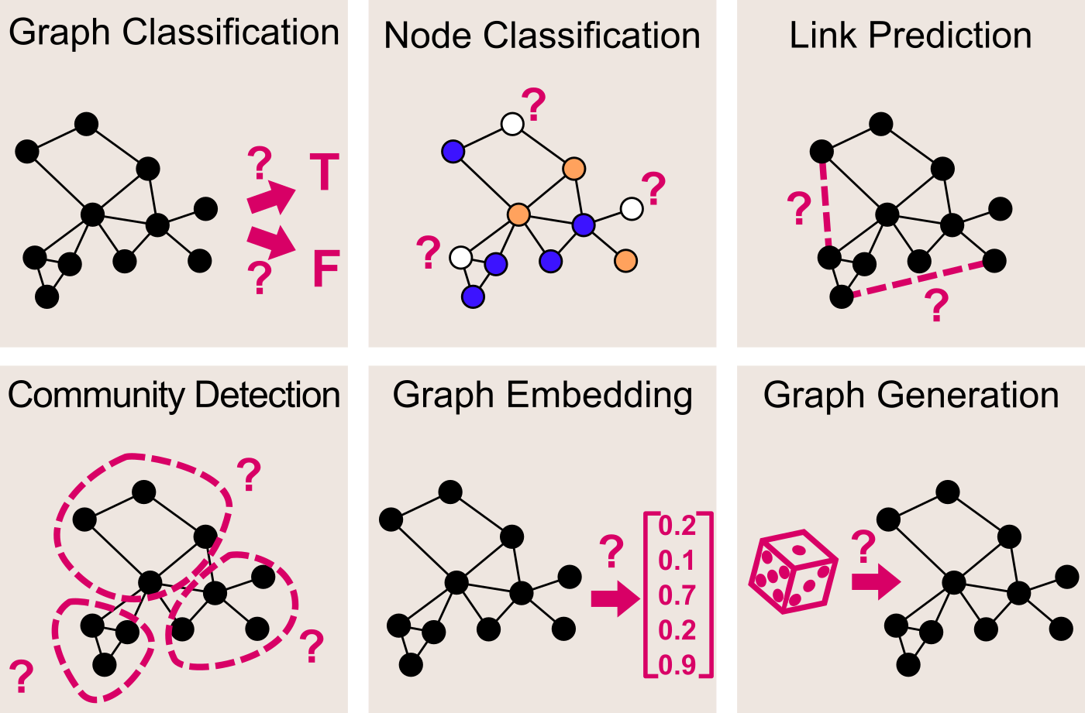
Single-instance learning
In real world… we are often given only one of something (e.g. design one building, navigate over one graph)
GNNs, like NNs, like being supervised by many instances and labels, but what if we have none?
NP-GNN: Given G = (V, E), can GNN learn the minimal S, with G being the supervision?
https://towardsdatascience.com/graph-convolutional-networks-deep-99d7fee5706f

Slide 7
Is self-supervision possible for learning metric dimension?
Prediction approach (previous work on MDP)
Input: Graph = (V, E)
GNN predicts nodes S ⊂ V
Reward = how close S is (verifier)
Update GNN parameters with reward
A solution S ⊂ V should… induce a “self-expressive” property, where:
[d(v, s), s ∈ S] is unique amongst v ⊂ V
Autoregressive approach (previous work)
Build S incrementally
Train GNN policy (pick action) and GNN critic (value function)
Requires supervision from verifier or labels!
Works badly for single instances
An approximate solution S ⊂ V should…
Idea 1: Satisfy (1) but instead of [d(v, s), s ∈ S], replace with GNN representation H
Idea 2: Be “unique” by finding Z s.t. HZ = I, i.e. basis coordinates
Does not require verifier!
Works well on single instances!
Michael Sun (2023). PP-GNN: Pretraining Position-aware Graph Neural Networks with the NP-hard metric dimension problem. Neurocomputing, 126848.

Slide 8
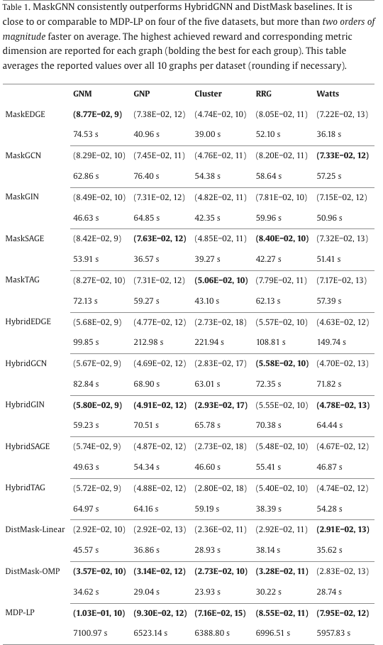
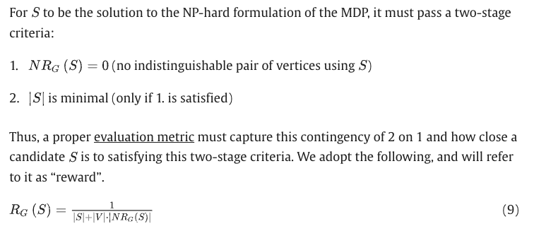
Results on learning the MDP
R_{G}(S) = 1/(|S|+|V|*|NR_{G}(S)|)
(NR_{G}(S) = #pairs S cannot distinguish)
vs GNN baseline: 151-172% reward
vs Integer programming: >100x faster, up to 98% reward
vs DistMask baselines: Ablation of idea 1
Michael Sun (2023). PP-GNN: Pretraining Position-aware Graph Neural Networks with the NP-hard metric dimension problem. Neurocomputing, 126848.

Slide 9
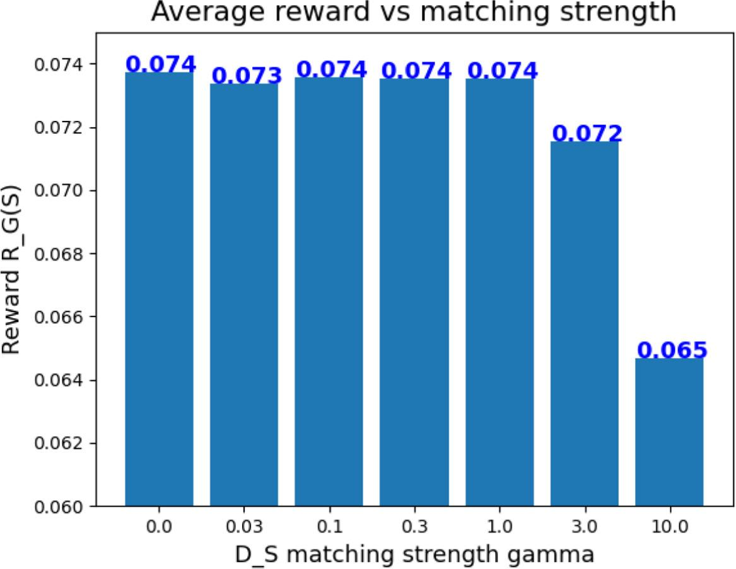
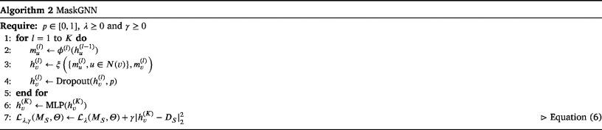
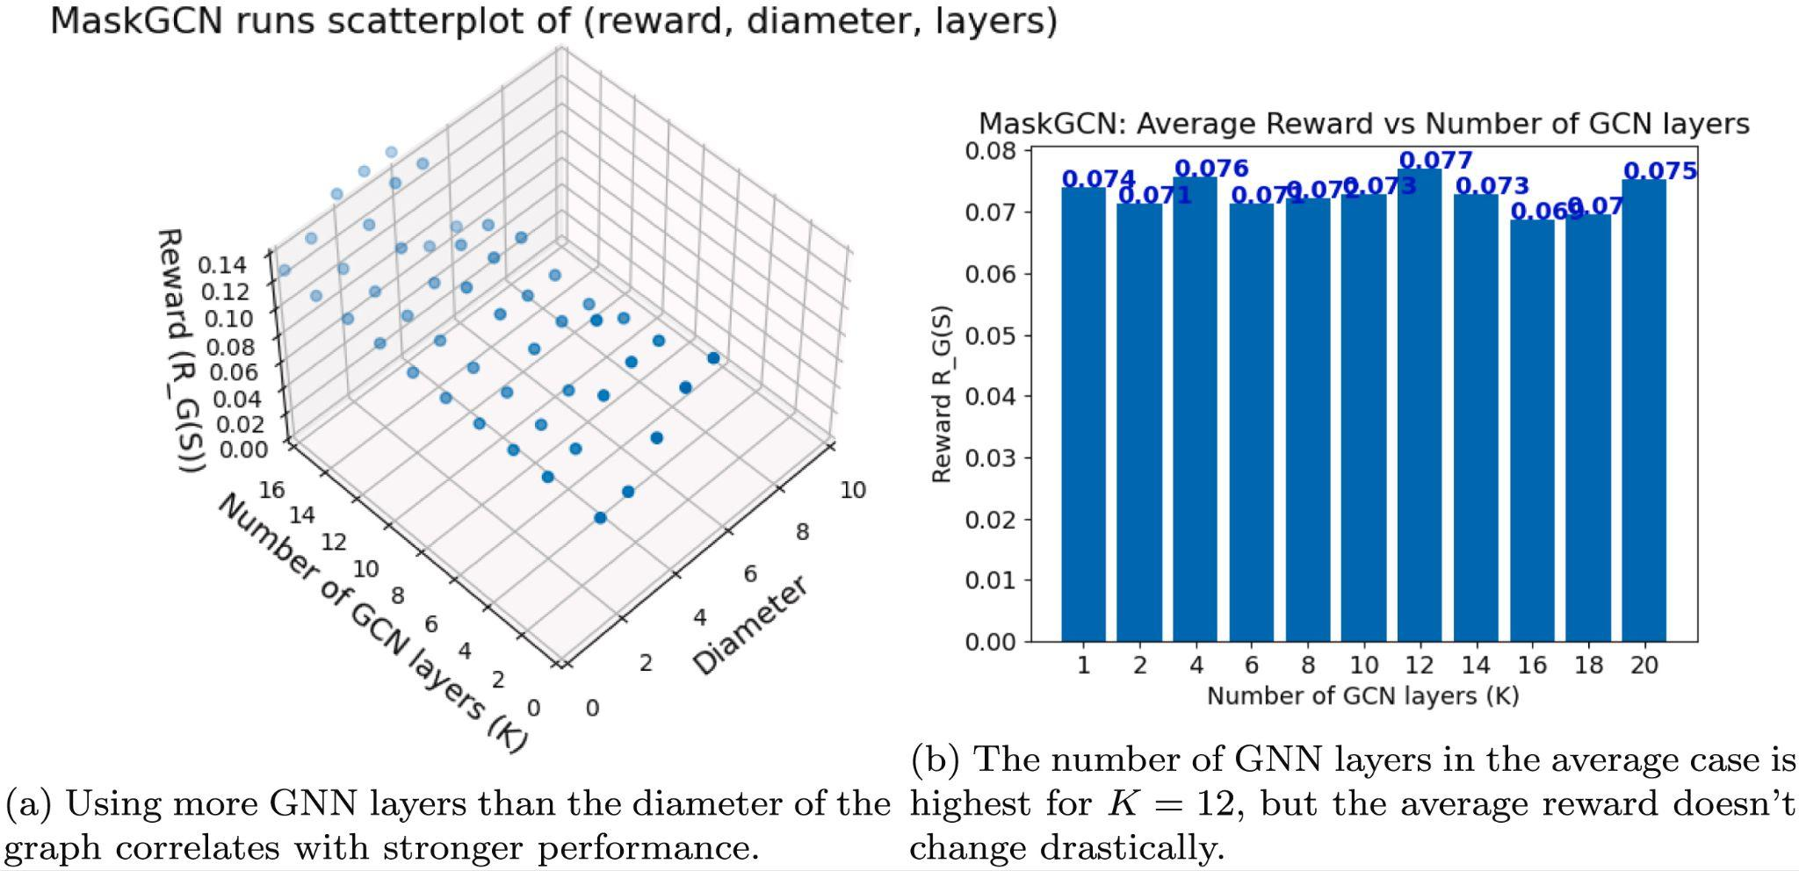
Ablation: Does idea 1 help?
Matching strength
Idea 1: Satisfy [d(v, s), s ∈ S] is unique amongst v ⊂ V ; instead of D := [d(v, s), s ∈ S], learn to emulate with H_{K} := GNN(;)
Align H to D by introducing penalty => no alignment, best penalty is zero
New idea: Align #layers of GNN to diameter(G) => alignment at architecture level
Michael Sun (2023). PP-GNN: Pretraining Position-aware Graph Neural Networks with the NP-hard metric dimension problem. Neurocomputing, 126848.

Slide 10
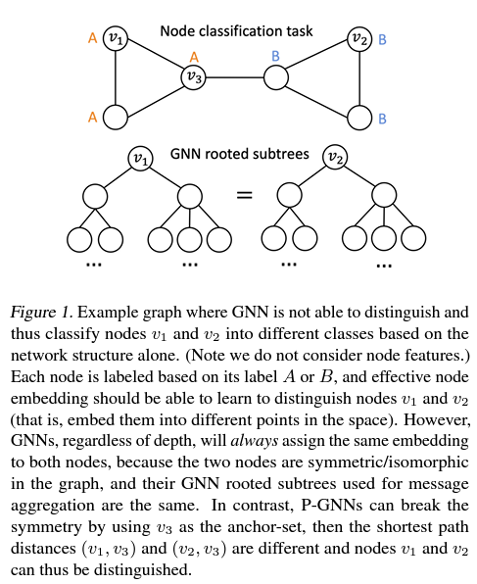
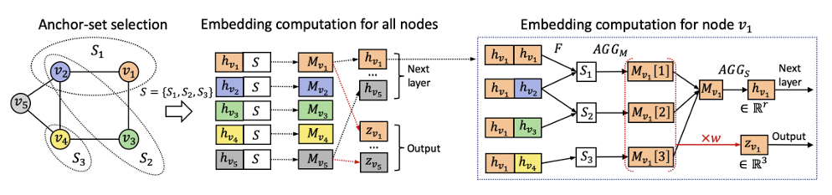
Background: Making GNNs more powerful with anchors
Idea: Augment h_{v} with distances D_{S}, e.g.
S₁ = (v₂, v₁), S₂ = (v₂, v₃), S₃ = (v₄) => h(v₁) += [[1, 0], [1,1], [2]]
Problem: S_{i}’ s are sampled randomly per layer
Bourgain’s Theorem: need O(log²n) sets to embed into different points in R^{k} with low distortion error
You, Jiaxuan, Rex Ying, and Jure Leskovec. "Position-aware graph neural networks." International conference on machine learning. PMLR, 2019.

Slide 11
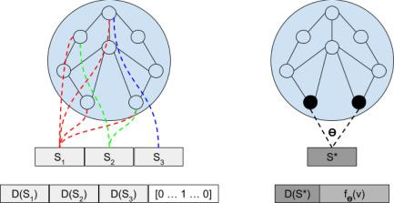
Solving the MDP leads to minimal, canonical anchors
Previous framework
Heuristic-based selection of S (random => P-GNN, vertex cover => A-GNN, edge shell => AS-GNN, entropy => IEA-GNN…)
Augment h^{k}(v) with D_{S} during training + inference per layer k
Pretraining framework
Learn MDP on single instance => h
Initialize h⁰(v) with h^{K}(v)
Augment h^{k}(v) with D_{S*} during training/inference per layer k
Michael Sun (2023). PP-GNN: Pretraining Position-aware Graph Neural Networks with the NP-hard metric dimension problem. Neurocomputing, 126848.

Slide 12
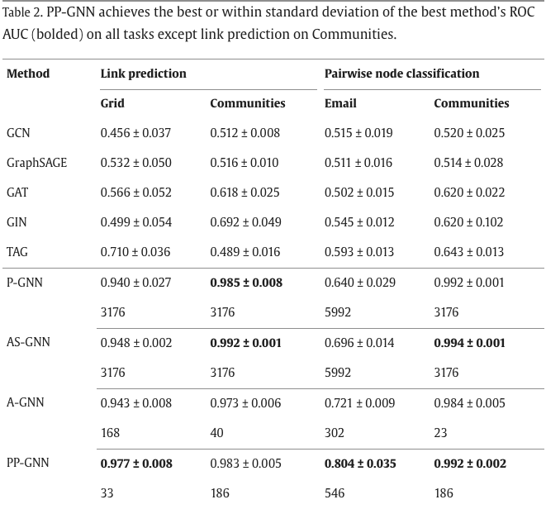
Pretraining on MDP yields position-aware representations
Node classification (A/B)
Link Prediction (--/--)
(0, 2) +
+ (3, 1)
Compare typical GNN tasks on graphs which are “positionally ambiguous”: Grid (20x20 grid), Communities (Connected Caveman, 20 communities, 20 each)
Add semantic features with Email (7 real-world email communication graphs, each with 6 communities)
Michael Sun (2023). PP-GNN: Pretraining Position-aware Graph Neural Networks with the NP-hard metric dimension problem. Neurocomputing, 126848.

Slide 13
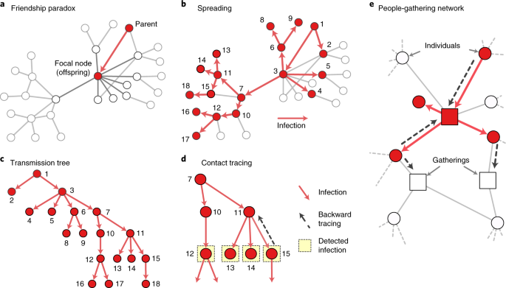
Future directions
Given arbitrary graphs, we have a fast approximate solver of the metric basis.
Improve the solver
Apply the solver
See Scholarpedia for some non-obvious applications, e.g.:
Disease source localization
Featurization of genetic sequences
In what other problems does position matter?
Let me know your ideas! Reach out!
msun415@mit.edu
Kojaku, Sadamori, et al. "The effectiveness of backward contact tracing in networks." Nature physics 17.5 (2021): 652-658.

